Slide 1
Project Title:
Air Flow Test Cycle Time Reduction
GB Candidate: Jerry Brown
MBB/Mentor: Jim Cosgrove
APT Workflow Request Number: 141671626
Team Members:
Engineering – Dale Hampshire
Engineering – Gabriel Jimenez
Manufacturing – Chris Durnell
Manufacturing – Chris McNaughton
Supply Chain – Richard Guiney
Notes:
APT Workflow Request Number should be 8 or 9 numbers (Ex: 99226633 or 100226633) This is different than a Record # or Entry#
*This Slide is intended for Black Belt projects, but can be leveraged as needed.

Slide 2
Problem Statement:
This project is addressing the manual rework that is currently required at our Unison Shop on the airflow analysis equipment. The airflow equipment measures the volumetric airflow and verifies that the part is meeting the engineering drawing specification. If the part is not meeting the engineering drawing specification a manual rework process is required to increase or decrease the volumetric air flow. A 2014 baseline assessment shows that 119 hours are being consumed to rework parts at the airflow test stand that will limit, and possibly jeopardize, upcoming NPI hardware throughput.
Definition of Terms & Acronyms:
HPT – High Pressure Turbine
ACC - Active Clearance Control
NPI – New Product Introduction
PIP – Performance Improvement Plan
QTY – Quantity
VSE - Vendor Substantiation Evaluation
FTY – First Time Yield
AVG – Average
QPE – Quantity per Engine
PIC – Product Integration Center
PEC – Product Engineering Center
MRB – Material Review Board
AIS – Airflow Inspection Standard
PSIG – Pounds per square inch gage pressure
CTQ – Critical to quality
MSA – Measurement System Analysis
ROI – Return on Investment
PCB – Program Control Board
Notes:
Problem Statement:
Give a high level statement indicating what is the problem that is being addressed and the business significance of the project. The problem statement should be specific and to the point.
Definition of Terms & Acronyms:
The reviewer may have a background different than the subject matter. The reviewer’s background may be engineering, IT, finance, sourcing, marketing, human resources, manufacturing, etc. Define any important terms used in the pitch that is pertinent to understanding the project. Define all acronyms used in the pitch.

Slide 3
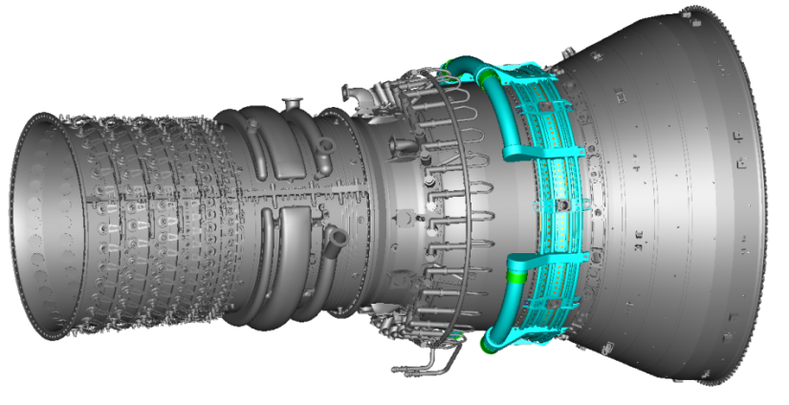
1. Why is the project important to the business and our Customers?
It is important to the business and our customers because this project will reduce manual rework time on the airflow test equipment stand by increasing FTY that will increase capacity for upcoming NPI programs.
 | Threat/Opportunity Matrix:
 | Threat | Opportunity
 | (if we don’t make this change) | (if we do make this change)
Short Term | Continue to use resources for rework | Free up resources
 | Drive increased part cost | Reduce part cost
Long Term | Not meet customer demand | Free up equipment for higher volume NPI programs
 | Drive increased part cost | Reduce part cost
Increase FTY
Standardize Process
CF6 HPT ACC Air Manifolds
1473M25 & 1473M26
Notes:
DEFINE
1. Why is the project important to the business and our Customers?
Simply define the problem and why it is important to the business?
Voice of Customer (VOC)
Choose projects that have business impact (Connect to high level Business Y’s)
List out key project stakeholders and the groups they represent.
Buy-in from key stakeholders (Using CAP tools)
Define tools to consider using:
Pareto Analysis
Tree Diagram
SIPOC
Top-down flow diagram
Traditional process map
Deployment flow diagram
Value Stream Map
CAP Tools
GRPI Model
In & Out of the Frame
Threat / Opportunity Matrix
Three D’s Matrix
May include the Division Benefiting from Project: e.g. (Systems, Supply Chain, IT, Finance….)
Business Y examples: (Inventory; Receivables/Progress; Payables; Pricing; Commercial Simplification; NPI/Technology;CSA;MCP;VCP; Material Deflation;ACFC;PMA) OR
(Engineering Cost Out; Inventory & Cost Out; Commercial Simplification and Pricing; Delivery; Proposal Delivery; Repair TAT; Technical Response)

Slide 4
2. What specific process needs to be improved?
On Time Delivery
Quality
Growth
2015 Supply Chain G/O’s
Key Supply Chain Initiative
Department Level Focus
Delivery
Reliability
Cost
CF6 engine line driving largest defect on air flow stand
PIC
PEC
Systems
CF6 ACC Manifold is driving largest defect
CF6-HPT ACC Manifold is driving largest defect
CF6-HPT ACC Manifold is driving largest defect and generating the highest rework rate
Elano
GE90
GEnx
CF6
LEAP
P20
Fuel Tubes
Air Hoses
Air Manifolds
Hydraulic Tubes
Oil Tubes
HPT ACC Manifolds
LPT ACC Manifolds
MRB
Rework
Cycle Time
Elano team decided to focus on areas driving abundant rework to meet drawing requirements
Hooksett
Project Y: Rework of CF6 HPT ACC Manifolds
Notes:
DEFINE
2. What specific process needs to be improved?
Scope from a Problem down to a manageable Project.
Use Data to make scoping decisions.
Clearly document existing process (Define Value Stream)
Scope and focus a project so it is manageable
Tree Diagram using data to go from a Problem to a Project
Define tools to consider using:
Pareto Analysis
Tree Diagram
SIPOC
Top-down flow diagram
Traditional process map
Deployment flow diagram
Value Stream Map
CAP Tools
GRPI Model
In & Out of the Frame
Threat / Opportunity Matrix
Three D’s Matrix

Slide 5
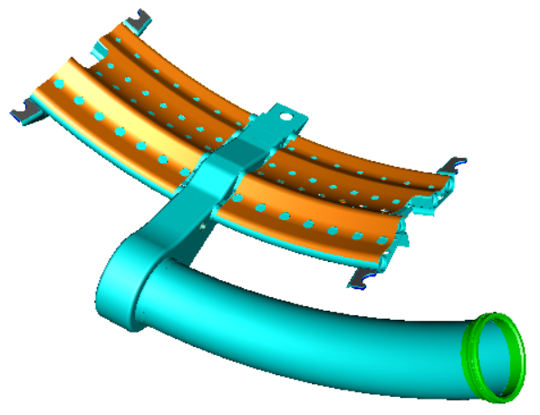
3. How is process performance measured?
Process Output: CF6 HPT Air Manifold that meets air flow CTQ.
Project Y with detailed quantification:
CF6 HPT Air Manifolds need to meet a specific air flow range requirement determined by the engineering drawing. Unison’s air flow test stand is used to determine air flow rates for final inspection to determine if rework is required to meet the air flow range.
Data type of Project Y: Air Flow, continuous data.
Defect Definition:
CF6 HPT Air Manifolds (1473M25 & 1473M26) need to pass an air flow requirement of 0.128 – 0.136 pounds per second with 2.5 PSIG static pressure maintained across the manifold.
Was MSA needed? Yes, see next slide.
0.128 – 0.136 lbs./sec
2.5 PSIG
(from test equipment)
Notes:
MEASURE
2. How is process performance measured?
Is it clear how a specific data point is established? If someone familiar with the process audited the project could they reasonably recreate the data based on the Project Y description?
If cycle time is measured is it precisely defined when the clock is started and when it is stopped?
If the data is extracted from a database is the database specified?
Is it clear what data type is used to quantify the project Y? (i.e. Continuous, Discrete-Defects, Discrete-Defectives)
Is the “Process Output” clearly defined? (i.e. part, document, account, information, time period, etc.)
If continuous data, is the measurement unit of the Y specifically stated? (i.e. inches, days, $, etc.)
Operational Definitions answer 3 questions:
What are you measuring? (Process Output, Project “Y” characteristic)
How are you measuring it? (Quantification of Project “Y” . Dollars, Time, Counts, etc.)
What is the customer requirement you are trying to meet? (Customer Requirement or Specification, defect definition)
Measure tools to consider:
Operational Definitions
Cause & Effect Diagram
Gage R&R / MSA

Slide 6
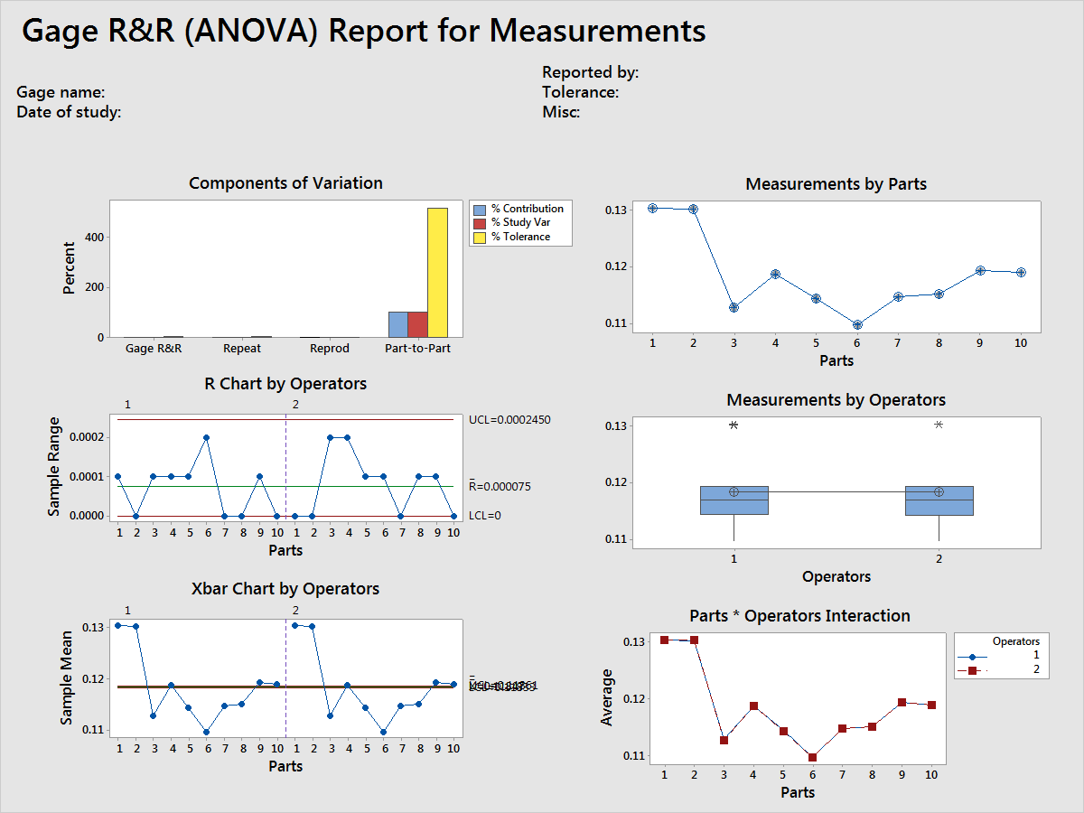
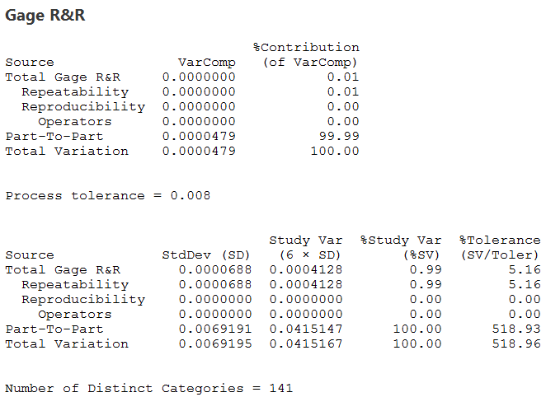
3. How is process performance measured?
Was MSA needed? Yes, Part Number 1473M25 was used for Gage R&R.
Gage R&R: 2 operators, measuring 10 parts, 2 replications. The tolerance of the air flow measurement is .0013 lbs./sec at 2.5 PSIG static pressure.
99% of the total variance is due to the part-to-part variance
Measurement system is valid
5.16% is below the 10% that meets the standard inspection requirement for product acceptance
0.99% study variation indicates what percent of the total variation observed in the Gage R&R study can be attributed to measurement error.
Notes:
MEASURE
2. How is process performance measured?
Is it clear how a specific data point is established? If someone familiar with the process audited the project could they reasonably recreate the data based on the Project Y description?
If cycle time is measured is it precisely defined when the clock is started and when it is stopped?
If the data is extracted from a database is the database specified?
Is it clear what data type is used to quantify the project Y? (i.e. Continuous, Discrete-Defects, Discrete-Defectives)
Is the “Process Output” clearly defined? (i.e. part, document, account, information, time period, etc.)
If continuous data, is the measurement unit of the Y specifically stated? (i.e. inches, days, $, etc.)
Operational Definitions answer 3 questions:
What are you measuring? (Process Output, Project “Y” characteristic)
How are you measuring it? (Quantification of Project “Y” . Dollars, Time, Counts, etc.)
What is the customer requirement you are trying to meet? (Customer Requirement or Specification, defect definition)
Measure tools to consider:
Operational Definitions
Cause & Effect Diagram
Gage R&R / MSA

Slide 7
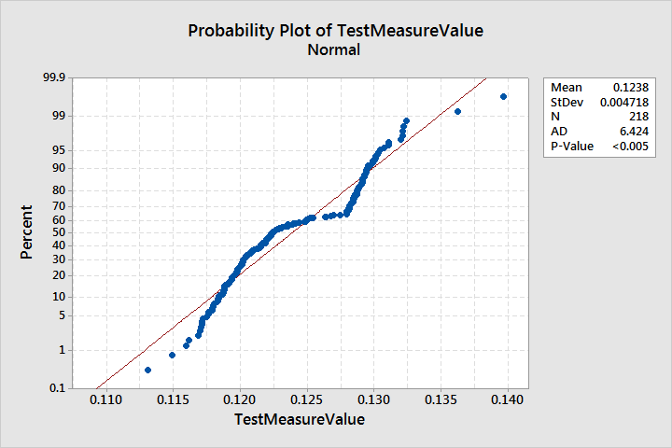
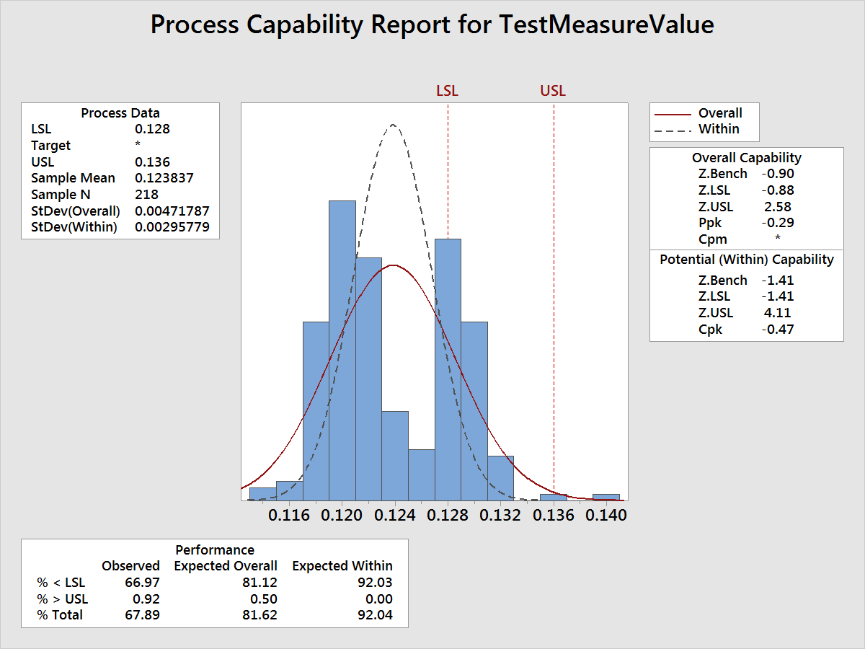
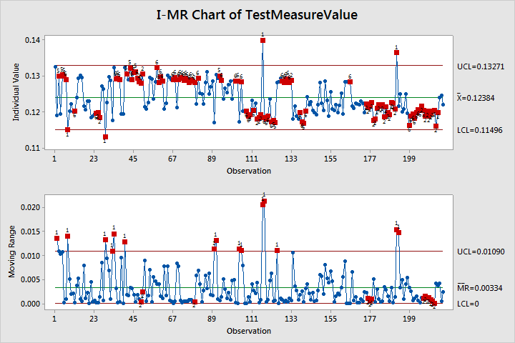
4. How is the current process performing?
P-Value < 0.05, non-normal & not predictable data
Capability Analysis:
(Non-Normal Data, used Observed Data)
P(d) or Probability of a defect = 67.9%
FTY = 32.1%
Z _{Bench} or Sigma Level = -0.46 (probability of defect, or the area under the curve outside the specification limits)
Process is not stable and out of control
I-MR Chart & Process Capability Chart clearly show two distinct processes or a process shift.
Notes:
4. How is the current process performing?
Was the capability analysis performed on the Project Y as defined in question 3?
Has the baseline been quantified with an appropriate metric? Examples are: Z_{LT} (Sigma Level), P(d), FTY, DPMO, DPU?
Was the stability / predictability of the data checked? (I-MR)
Was normality of data checked?
Measure tools to consider:
Graphical: Time Series, Histogram, Dot Plot
I-MR, Process Behavior Chart

Slide 8
5. What are the Big X’s?
Measurements
Materials
Men & Women
Air Flow Machine
Experience with equipment
Static Pressure
Part Design
Inlet Pressure
Erroneous entries into computer
Inlet Temperature
Number of cooling holes
X₁
Equipment Setup / attaching part to flow test machine
Upper Spec Limit
X₃
3
Hole Diameter
2
Manifolds Not meeting drawing requirements during flow testing on air manifolds
3
X₂
Lower Spec Limit
Test Run Time
Air Pressure
Failure to run AIS test
Fixtures for laser drilling cooling holes
Capability of Air Flow Equipment
Humidity
1
X₄
Atmospheric Pressure
Targeting nominal cooling hole size
3
X₅
Laser variation for drilling cooling holes
1
X₆
Ambient Temperature
Tooling offset
Environment
Methods
Machines
Impact
Xs identified via:
Subject Matter Expert(s)
Brainstorming
 | High | Low
Easy | 1 | 2
Hard | 3 | 4
Implement
1
2
3
4
Notes:
5. What are the Big (Vital Few) Xs?
Were the Big X’s specifically stated?
Was the significance of the big X’s demonstrated using a statistical tool(s)?
Note: If a graphical tool highlights an obvious big X a statistical tool is not necessary.
This is our purpose – find the big Xs. 20% percent of the causes are 80% of the problem.
Was the percentage of the variation explained by the X’s or a comparable quantification specified?
Is it clear how the quantification was established? Where did the numbers come from?
If a Pareto chart was used was each category clearly defined?
General process order:
Use the I-MR chart to find Big Xs.
Use visual/graphical analysis to determine the Big Xs.
Use the Staged I-MR chart to find/confirm Big Xs.
Confirm your analysis with statistical tools when needed.
Use Value Stream Maps to identify and then remove waste (Xs).
Determine the impact of the Xs on the Y to decide which Xs to invest in fixing.
Analyze tools to consider:
I-MR Chart
Multiple Dot Plots
Multiple Box Plots
Scatter Plot
Matrix Plot
Multi-Vari Plot
Cause-Effect Diagram
ANOVA
TEV
Regression
Seven Wastes
Value Stream Map

Slide 9
6. What was done to the Big X’s to improve the process?
Big X’s | Cause of Variation | Improvement Plan
X₁ & X₂ - Upper & Lower Spec Limits | The process capability of the equipment can not meet the design specifications. | Proposed solution of increasing the drawing tolerances. This proposal was rejected at PCB/Tech Review due to ROI for CF6 Program
X₃ - Equipment setup | Confirmed through gage R&R that equipment setup does not cause variation in the process. | No action required
X₄ - Nominal hole size target | Confirmed that nominal hole size target is controlled by the laser program thru the Value Process Engineer and not the operator. | No action required
X₅ - Laser variation for drilling cooling holes | Two lasers resulting in bi-modal data within operation. | Selected the laser that delivered better process capability
X₆ - Tooling offset | The focal length of the laser drives variation as the laser beam converges or diverges to the cutting surface of the part. | Operator can make tooling offset adjustments to control laser beam focal point within the specifications
Notes:
6. What was done to the Big Xs to improve the process?
Did the improvement plan specifically address each X identified in question 5?
Were all the X’s addressed in the improvement plan?
Provide a technical & human solution (CAP tools)
Clearly document what was done to the Big X’s to improve the process
Design your new process based on what you learned in the Analyze phase
Analyze & address sources of resistance
Improve tools to consider:
Key Constituents Map
Stakeholder Analysis
TPC Analysis
Influence Strategy
Impact vs. Effort Chart
I-MR Chart
Staged I-MR Chart
5S
7 Ways
Moonshine

Slide 10

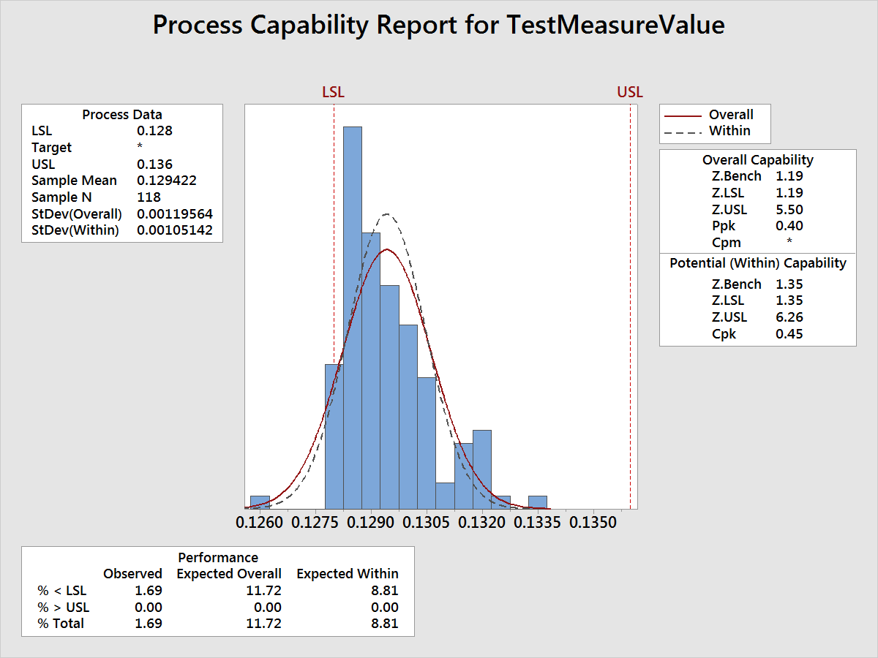
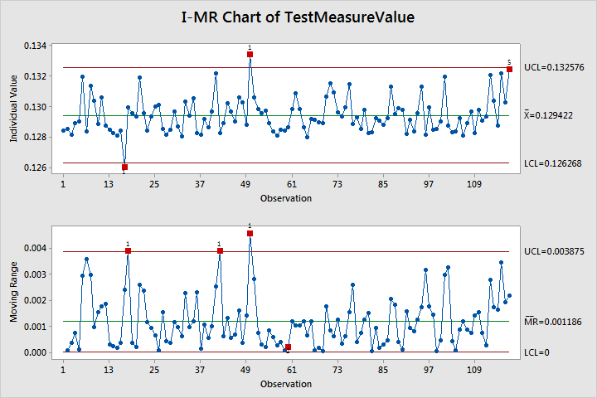
7. How is the improved process performing?
Capability Analysis:
(Non-Normal Data, used Observed Data)
P(d) or Probability of a defect = 1.69%
FTY = 98.31%
Z _{Bench} or Sigma Level = 2.12 (probability of defect, or the area under the curve outside the specification limits)
Process is more stable and more in control
Notes:
7. How is the improved process performing?
Was the improved capability analysis performed on the Project Y as defined in question 3?
Has the baseline been quantified with an appropriate metric? Examples are: Z_{LT} (Sigma Level), P(d), FTY, DPMO, DPU?
Was the stability / predictability of the data checked? (I-MR)
Was normality of data checked?
Was the impact quantified by comparing the baseline capability data used in question 3 to data collected after the process was improved? (i.e. Process Behavior Chart comparing before and after improvements, DPMO reduction, decrease in P(d), increase in FTY and Z_{LT} (Sigma Level) .)
Improve tools to consider:
I-MR Chart
Staged I-MR Chart
FMEA

Slide 11
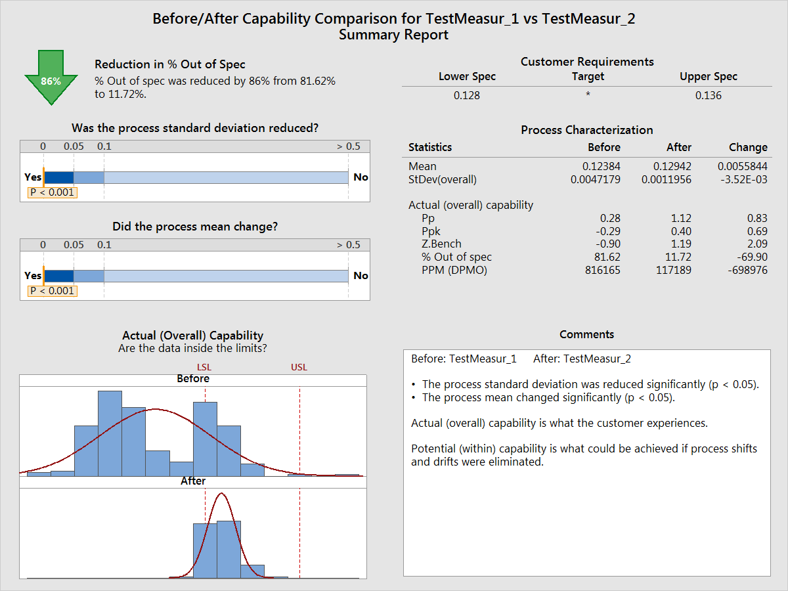
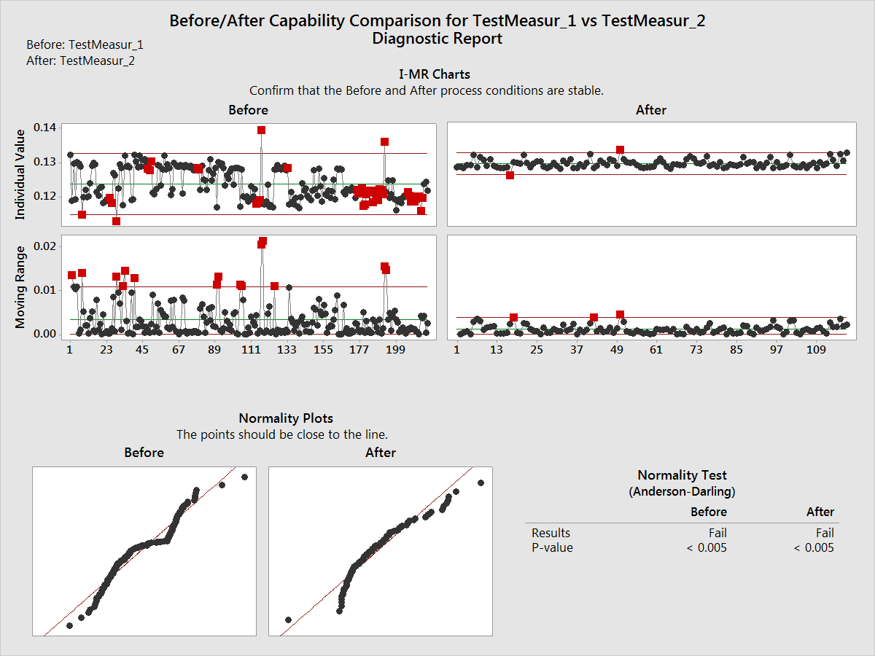
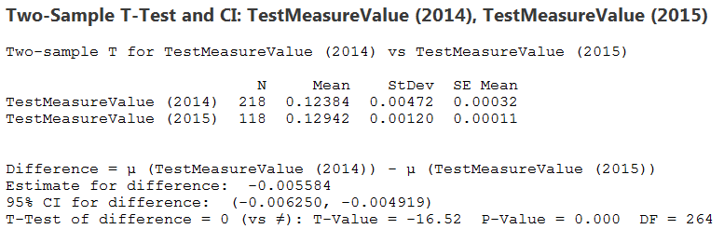
8. What is the statistical evidence of process improvement?
Ho: 𝜇Before = 𝜇After
P-value < .05 - Reject Ho,
There is a detectable
difference between before
and after process.
Statistical Data Proves Process Improvement
Notes:
8. What is the statistical evidence of a process improvement?
Was one of the following used to determine a statistical difference:
Staged I-MR
ANOVA or 2 Sample t-test and an HOV test, to indicate a difference in both the means and variance?
Chi-square test to indicate a difference in counts?
Moods Median and HOV, to indicate a difference in both median and variance? (for Stable Ops type projects where data is not normally distributed)
Any other applicable statistical test such as 2 proportions, paired t-test, etc.
Note: If the difference is obvious when using a graphical tool a statistical test is not necessary.
Statistically confirm that the capability of the new process is statistically different than the capability of the old process.
Statistically confirm that the new process is stable and sustainable. (I-MR)
Improve tools to consider:
ANOVA
2 Sample t-test
HOV
Chi Square
Moods median
Paired t-test
2 Proportions

Slide 12
9. What can be done to ensure the improvement will last?
Hole size control plan
Big X | Control Plan | Owner
X₅ - Laser variation for drilling cooling holes | Two lasers were initially used to manufacture parts. The decision was made to move all of the parts to one laser to remove the bi-modal data from the process. A new laser is being purchased and installed in the shop as a backup. | Manufacturing Engineer
X₆ - Tooling offset | The hole diameters on every part are checked with a gage to determine if the laser is cutting within the specification. If the hole diameters are not meeting the specification the focal point of the laser can be adjusted by adjusting the tooling offset to meet the requirements. | Operators / Manufacturing Engineer
Notes:
9. What can be done to ensure the improvement will last?
Has a risk assessment been conducted on the control plan?
One of the following is required:
The process is being monitored and the following is specified:
A control limit has been established indicating when action is required.
The person or function required to take action has been identified.
A formal feedback loop has been established indicating the effectiveness of any corrective actions taken.
The project Y and Vital Few X’s (where applicable) are monitored.
Monitoring frequency is specified.
Process is not monitored and adequate justification is provided. i.e. error-proofing, digitized process, etc.
Identify and implement controls to ensure improvements stay in place
Monitor and control variation
Establish transition plan for maintaining control and review with the Leadership team/Stakeholders
Control tools to consider:
Stakeholder Analysis
Procedure Self Audit
Checklist
Error Proofing
Risk Management
Probability and Impact
Process Control Plan
Communication Plan
Rewards and Measures Assessment

Slide 13
10. How were the project improvement and benefits documented in the system?
APT Workflow Number: 141671626
1473M25 & 1473M26
FTY = 32.1%
Defect Rate = 67.9%
Average rework time = 0.25 hours
Total quantity of engines produced over the next year = 704
Rework rate = 67.9%
# produced * 67.9% * 0.25 hours
704 * .679 * .25 = 119.5 hours
CF6 Build Plan
Year | Engines | QPE | Total
3Q 2015 | 30 | 8 | 240
4Q 2015 | 17 | 8 | 136
1Q 2016 | 17 | 8 | 136
2Q 2016 | 24 | 8 | 192
Total | 88 | 8 | 704
This process change frees-up the air flow test measurement stand by 119.5 hours over the next year based on CF6 sales volume, which allows the shop to utilize the equipment to measure other engine line manifolds.
This project does not save any money. The time saved on the air test equipment is now used during the in-process check during the laser drilling process.
Notes:
10. How were the project improvement and benefits documented in the system?
Finalize the project savings
Document the project results, lessons learned and best practices
Document in APT, Aviation Project Tracking tool
What is the financial impact of your project?
Does your project have any Savings ?
If your answer is yes, are your savings Direct, Indirect, Cost Avoidance or Working Capital ?
What is the amount of the savings ?
How did you calculate your savings ?
Do you have any implementation costs ?
What financial account(s), e.g. Inventory, Price, are affected ?
If your answer is no savings, why ?

Slide 14
Appendix

Slide 15
Elano Air Flow Test Cycle Time Reduction - APT 141671626
Name: Jerry Brown
SSO: 212359018
Function/Division: Supply Chain
MBB: Jim Cosgrove
Location: Evendale, Ohio
Key Process that was improved?
Reduce manual modifications to ACC Air Manifolds
to meet air flow test requirements at the test stand.
Aviation Y/Division Y?
On-time delivery, NPI Readiness
Problem Statement:
The Supply Chain Division is tasked with on-time delivery and preparing for the upcoming NPI volume for 2015. This project will focus on reducing cycle time and increase throughput on the volumetric air flow test stand by reducing the manual drilling process that takes place to meet the pressure test requirements on the ACC Air Manifold.
Improvements Implemented:
This project improved the CF6 HPT ACC cooling manifold air flow test from a FTY of 32.1% to a FTY of 98.3% by putting some control requirements on the laser drilling process and in-process checks on the laser drilled holes for the shop operators to adhere to.
What can others learn from your project:
This project can be leveraged to all other programs that require HPT & LPT air flow analysis. As of now programs include GEnx, GE90, LEAP and Passport 20. In the future when setting the requirements of the mass airflow volume on the engineering drawing, the design engineers need to be cognizant of the process capabilities of the machines that are cutting the holes on the designated panels and the operating tolerances of the hardware they are designing.
Notes:
Optional 4-Blocker

